Slide 1
TOPIC MODELING
Siddhesh Tiwari
University of Illinois at Chicago

Slide 2

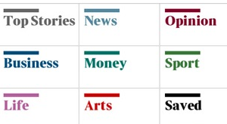
Motivation
Plethora of documents being published by news agencies
Organizing articles is important and challenging
Solution:
TOPIC MODELING

Slide 3

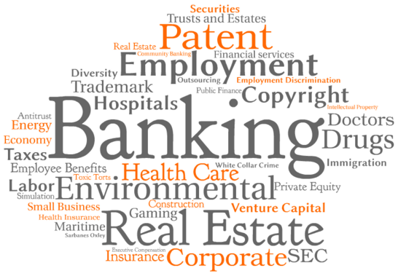
Data
Corpus of 2246 articles from Associated Press
Articles in corpus comes from variety of domain

Slide 4
Tools & Algorithm
Python
Gensim
Python library for Semantic Analysis and Topic Modelling
Contains implementation of LDA, LSA and other unsupervised learning algorithm for language processing
pyLDAvis
Python library to visualize topics generated from LDA
Latent Dirichlet Allocation

Slide 5
Implementation Flow
Documents
Preprocessing
Model
Evaluation
Visualize

Slide 6
Preprocessing
Divided single text file into 2246 text documents
Remove Non-ASCII values
Tokenize
Remove Stopwords
Remove word with frequency less than 2 and length less than 5

Slide 7
Model
Number of topics
Number of iterations
Document-Term matrix
Use LDA implementation from genism library to train the model

Slide 8
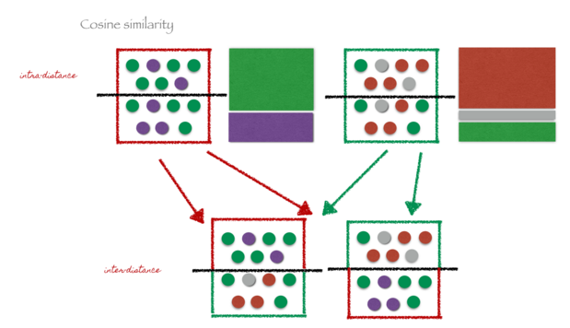
Evaluation
Split each testing documents into two parts
Compute average cosine similarity between corresponding halves with respect to topics. This Metric should be higher.
Compute average cosine similarity between halves of different documents. This metric should be small.

Slide 9
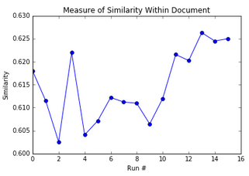
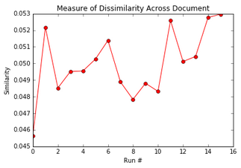
Evaluation

Slide 10
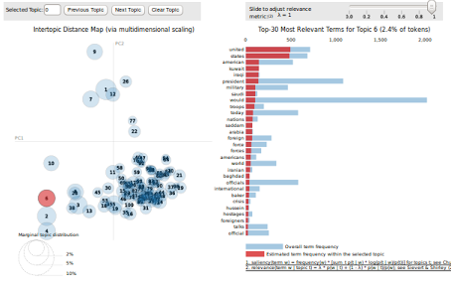
Visualization
Used pyLDAvis library for generating interactive visualization for topics

Slide 11
Applications
Topic similarity among documents can be used to organize documents in news portals, online library and research paper publishers
Topic modeling can be used to build recommendation engine for online magazines by using topic similarity between documents and preferences of users.

Slide 12


